Slide 1


AI Based Early Screening of Prosopagnosia using Multimodal Electroencephalography and Diagnosis-Specific Questionnaire (Paper ID – 490) R. Lakshmi, Aadithya Arunachalam, Anapalli Arjun, Varun Radhakrishnan
Presented By – R. Lakshmi (SRM Valliammai Engineering College)

Slide 2

Presentation Outline
Introduction
Literature Review
Problem Formulation / Problem Description
Novelty of the Proposed Work
Proposed Methodology
Dataset Details / Benchmark / Simulation Platform
Experimental Results
Conclusion
Bibliography

Slide 3
Introduction
Prosopagnosia (face blindness) is a neurocognitive condition affecting familiar face recognition.
Early screening is crucial, especially for children, to enable timely intervention and support.
Existing methods rely on subjective questionnaires or slow behavioural tests, limiting accuracy and usability.
EEG offers objective neural biomarkers (e.g., N170) but is rarely used for technical diagnosis in real-time screening systems.
Current research lacks a multimodal framework combining EEG-based neural evidence and behavioural symptom assessment.
This work proposes an AI-based early screening system integrating EEG analysis with a diagnosis-specific questionnaire for improved reliability and interpretability.

Slide 4
Literature Review
S.No | Title & Year | Authors | Method / Focus | Key Findings
1 | Prosopagnosia: Face Blindness and Its Association With Neurological Disorders (2024) | Kennedy A. Josephs et al. | Literature review of developmental/acquired prosopagnosia cases. | Linked to fusiform damage; urged better screening and rehabilitation methods.
2 | A New Approach to Diagnosing and Researching Developmental Prosopagnosia: Excluded Cases Are Impaired Too (2022) | Edwin J. Burns et al. | Compared diagnosed and borderline DP cases with face/object tests. | Borderline cases still impaired; proposed spectrum-based diagnosis.
3 | Performance Comparison of Different EEG Analysis Techniques Based on Deep Learning Approaches (2021) | Swarali Belsare et al. | Compared CNN, RNN, and hybrid models on EEG datasets. | CNNs performed best; hybrids improved spatial–temporal feature capture.
4 | Challenging Deep Learning Methods for EEG Signal Denoising Under Data Corruption (2024) | Farzaneh Taleb et al. | Tested CNN autoencoders and GANs under simulated noise. | Severe corruption reduced accuracy; highlighted need for spatial–temporal priors.

Slide 5

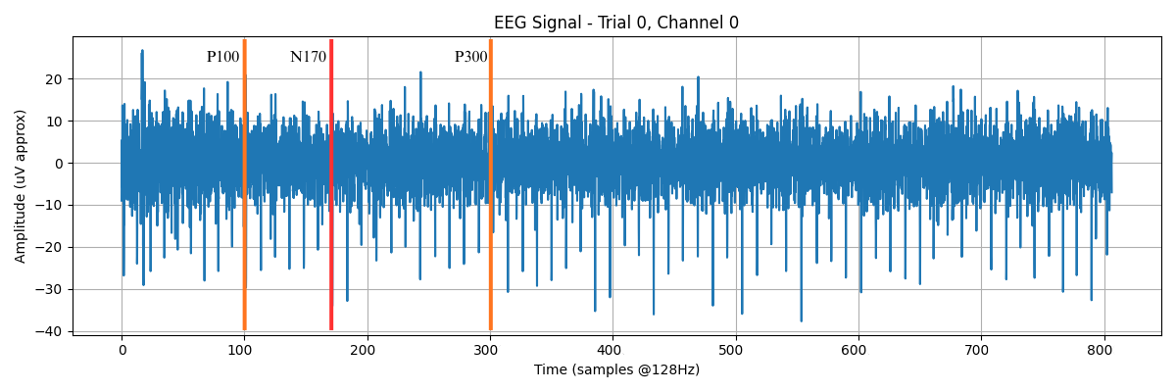
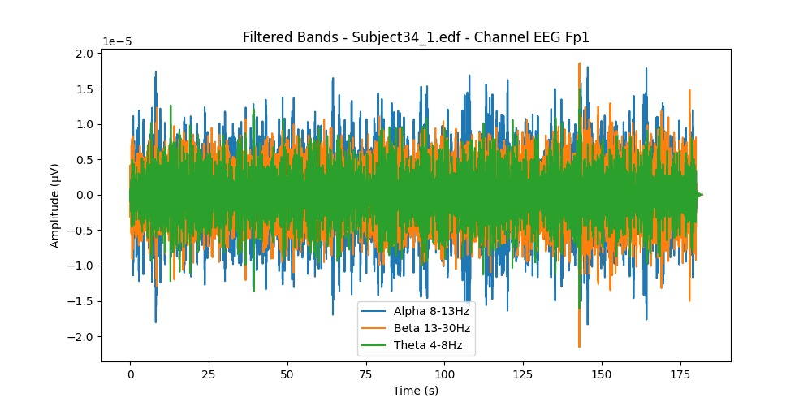
Problem Formulation/ Problem Description
Prosopagnosia affects face-recognition ability, requiring early and reliable screening.
Existing behavioural tests are subjective and time-consuming, while EEG studies are restricted to research settings.
No current system integrates EEG biomarkers with symptom-based questionnaires for accurate early detection.
A unified AI model is required to fuse neural and behavioural data into a single, reliable screening decision.

Slide 6
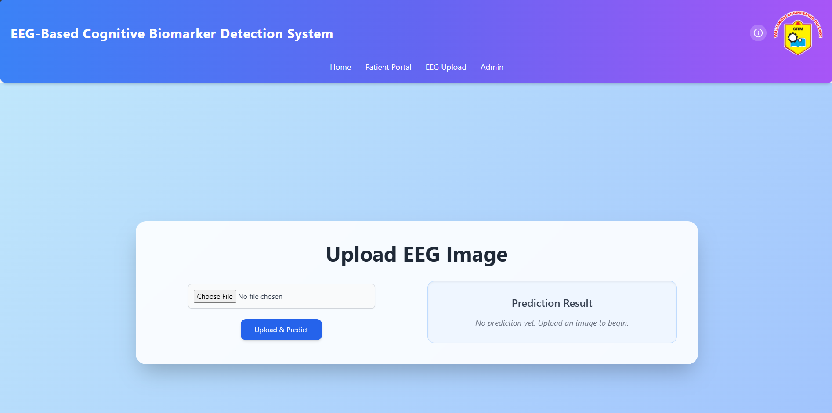
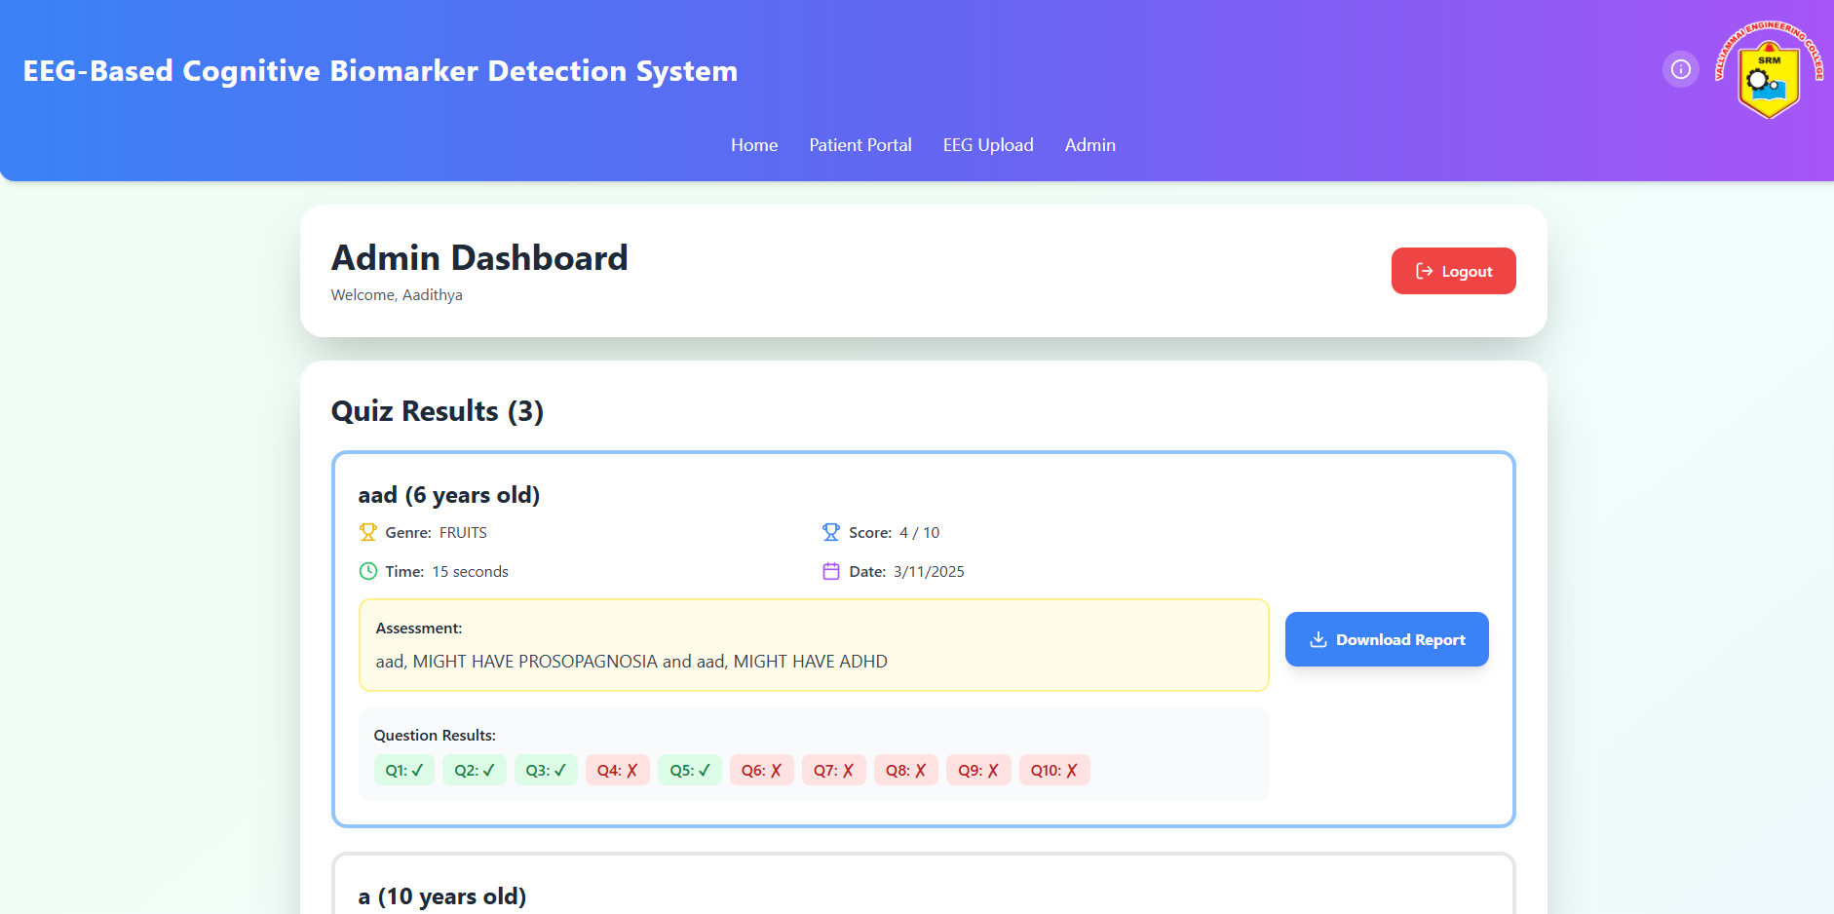
Novelty
First multimodal framework combining EEG-based neural biomarkers with a diagnosis-specific questionnaire for prosopagnosia screening.
Utilizes CRNN architecture to capture both spatial and temporal EEG characteristics, improving classification accuracy.
Introduces weighted decision fusion, enabling a unified and more reliable diagnosis compared to unimodal methods.
Converts EEG into ERP-based image representations (spectrograms/topographies) for enhanced feature learning.
Designed as a non-invasive, child-friendly early screening tool, suitable for practical educational and clinical environments.

Slide 7
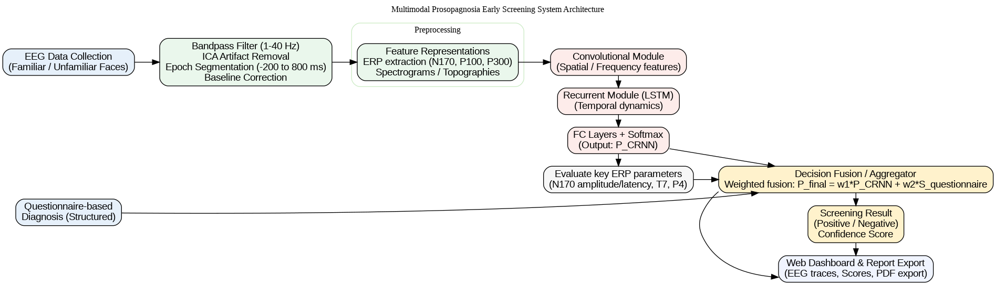
Proposed Method
EEG data is converted into image-based representations (spectrograms/topographies) for deep-learning processing.
A CRNN model combines CNN (spatial features) and LSTM (temporal patterns) for EEG classification.
A 15-item diagnosis-specific questionnaire is scored and normalized to represent behavioural indicators.
A weighted fusion approach integrates EEG predictions with questionnaire scores to produce the final screening decision.
Results, confidence levels, and ERP patterns are displayed through a web-based visualization dashboard.

Slide 8
Dataset Details/ Benchmark/ Simulation Platform
EEG data recorded during a controlled face-recognition task using familiar and unfamiliar facial stimuli.
OPEN SOURCE DATA, and selective samples of SELF-TAKEN EEG SCANS
Signals sampled in the 1–40 Hz range, segmented into epochs (–200 ms to +800 ms) for ERP extraction.
Dataset includes corresponding behavioural questionnaire responses scored on a 5-point Likert scale.
Preprocessing and feature extraction performed using Python (MNE, NumPy, SciPy).
Model training and evaluation conducted on TensorFlow/Keras using a CRNN architecture.
Experiments executed on a GPU-enabled simulation platform for faster training and hyperparameter tuning.

Slide 9
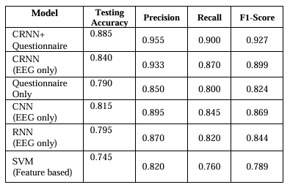
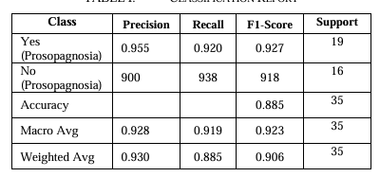
Experimental Results
The multimodal fusion approach achieved an overall classification accuracy of 88.5%, outperforming EEG-only and questionnaire-only models.
Questionnaire normalization contributed to consistent behavioural scoring, improving fusion stability.
Weighted fusion (0.7 EEG + 0.3 questionnaire) delivered the highest confidence scores and reduced misclassification.
4th International Conference on Innovations in Data Analytics (ICIDA 2025)

Slide 10
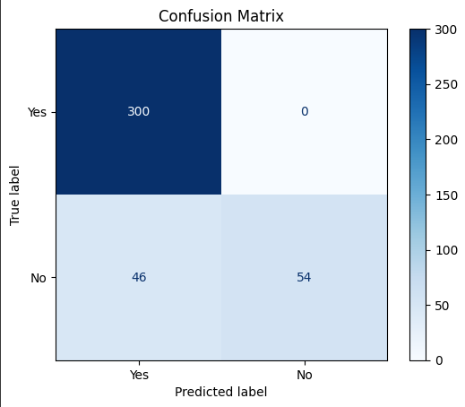
Conclusion
A multimodal AI framework was developed for early screening of prosopagnosia using EEG signals and a diagnosis-specific questionnaire.
CRNN-based EEG analysis effectively captured spatial–temporal neural patterns related to face recognition.
Behavioral questionnaire scores complemented EEG predictions, improving diagnostic reliability.
Weighted fusion of both modalities achieved higher accuracy than unimodal approaches.
The system is non-invasive, efficient, and suitable for real-time clinical or educational screening.
Provides interpretable outputs and automated reports, supporting practical adoption in future screening applications.

Slide 11
Bibliography
V. Manippa et.al., "The Neural Correlates of Developmental Prosopagnosia: Twenty-Five Years on," Brain Sciences, vol. 13, no. 10, p. 1399, 2023.
E. Nørkær et.al., "Disentangling developmental prosopagnosia: A scoping review of terms, tools and topics," Cortex, vol. 176, pp. 161–193, 2024.
S. Faghel-Soubeyrand et.al., "Neural computations in prosopagnosia," Frontiers in Neuroscience, vol. 18, Article 11127037, 2024.
A. Lueschow et.al., "The 170ms Response to Faces as Measured by MEG (M170) Is Consistently Altered in Congenital Prosopagnosia," PLoS ONE, vol. 10, no. 9, e0137624, 2015.
S. J. Kim et.al., "Regional Brain Analysis and Machine Learning Techniques for Classifying Familiar and Unfamiliar Faces Using EEG," Arabian Journal for Science and Engineering, 2024.
M. Tsantani et.al., "The Twenty Item Prosopagnosia Index (PI20) provides meaningful evidence of face recognition impairment," Cortex, vol. XX, no. XX, pp. XX–XX, 2021.
J. Van den Stock et.al., "Neural Correlates of Perceiving Emotional Faces and Bodies in Developmental Prosopagnosia: An Event-Related fMRI-Study PLoS ONE, vol. 3, no. 9, e3195, 2008.

Slide 12
Thank You

